Slide 1


Slide 2



Cryptarithmetic Quiz:
https://qrgo.page.link/6rT9W

Slide 3
DATA ARRANGEMENT

Slide 4
Question: 01
A, B, C, D and E are sitting on a bench. A is sitting next to B, C is sitting next to D, D is not sitting with E who is on the left end of the bench. C is on the second position from the right. A is to the right of B and E. A and C are sitting together. In which position A is sitting ?
Between B and D
Between B and C
Between E and D
Between C and E
Answer: B

Slide 5
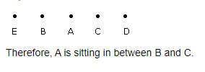
Explanation: 01

Slide 6
Question: 02
A, P, R, X, S and Z are sitting in a row. S and Z are in the centre. A and P are at the ends. R is sitting to the left of A. Who is to the right of P?
A
X
S
Z
Answer: B

Slide 7

Explanation: 02
The seating arrangement is as follows:
Therefore, right of P is X.

Slide 8
Directions to the questions 3-6
Five girls are sitting on a bench to be photographed. Seema is to the left of Rani and to the right of Bindu. Mary is to the right of Rani. Reeta is between Rani and Mary.

Slide 9
Question: 03
Who is sitting immediate right to Reeta ?
Bindu
Rani
Mary
Seema
Answer: C

Slide 10

Explanation: 03

Slide 11
Question: 04
Who is in the middle of the photograph ?
Bindu
Rani
Mary
Seema
Answer: B

Slide 12
Explanation: 04

Slide 13
Question: 05
Who is second from the right ?
Bindu
Reeta
Mary
Seema
Answer: B

Slide 14
Explanation: 05

Slide 15
Question: 06
Who is second from the left in photograph ?
Bindu
Reeta
Mary
Seema
Answer: D

Slide 16
Explanation: 06

Slide 17
Directions to the questions 7 - 11
In an Exhibition seven cars of different companies - Cadillac, Ambassador, Fiat, Maruti, Mercedes, Bedford and Fargo are standing facing to east in the following order :
Cadillac is next to right of Fargo.
Fargo is fourth to the right of Fiat.
Maruti car is between Ambassador and Bedford.
Fiat which is third to the left of Ambassador, is at one end.

Slide 18
Question: 07
Which of the cars are on both the sides of cadillac car ?
Ambassador and Maruti
Maruti and Fiat
Fargo and Mercedes
Ambassador and Fargo
Answer: C

Slide 19
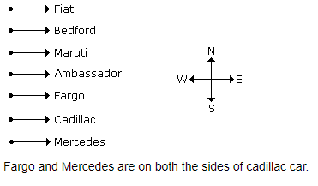
Explanation: : 07

Slide 20
Question: 08
Which of the following statement is correct ?
Maruti is next left of Ambassador
Bedford is next left of Fiat
Bedford is at one end.
D. Fiat is next second to the right of Maruti.
Answer: A

Slide 21
Explanation : 08

Slide 22
Question: 09
Which one of the following statements is correct ?
Fargo car is in between Ambassador and Fiat.
Cadillac is next left to Mercedes car
Fargo is next right of Cadillac
Maruti is fourth right of Mercedes
Answer: B

Slide 23
Explanation : 09

Slide 24
Question: 10
Which of the following groups of cars is to the right of Ambassador ?
Cadillac, Fargo and Maruti
Mercedes, Cadillac and Fargo
Maruti, Bedford and Fiat
Bedford, Cadillac and Fargo
Answer: B

Slide 25
Explanation : 10

Slide 26
Question: 11
Which one of the following is the correct position of Mercedes ?
Next to the left of Cadillac
Next to the left of Bedford
Between Bedford and Fargo
Fourth to the right of Maruti.
Answer: D

Slide 27
Explanation : 11

Slide 28
Directions to the questions 12-15
Six friends P, Q, R, S, T and U are sitting around the hexagonal table each at one corner and are facing the centre of the hexagonal. P is second to the left of U. Q is neighbour of R and S. T is second to the left of S.

Slide 29
Question: 12
Which one is sitting opposite to P ?
R
Q
T
S
Answer: D

Slide 30
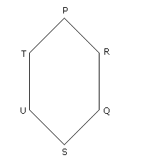
Explanation : 12

Slide 31
Question: 13
Who is the fourth person to the left of Q ?
R
P
T
S
Answer: B

Slide 32
Explanation : 13

Slide 33
Question: 14
Which of the following are the neighbours of P ?
U and P
T and R
U and R
Data inadequate
Answer: B

Slide 34
Explanation : 14

Slide 35
Question: 15
Which one is sitting opposite to T ?
R
P
Q
S
Answer: B

Slide 36
Explanation : 15

Slide 37
THANK YOU

